Slide 1
Cyber Physical Systems Project Products Packing Production Line
Milestone 1

Slide 2
Project description
A conveyor is used to transport a queue of products.
The products should be packed in boxes, where each box contains four products.
A rotating conveyor is used to distribute the products to four different conveyors. Whenever a product reaches the end of its conveyor, it is dropped in an empty box. When the box is full, it is moved to be wrapped.
A conveyor is used to carry the box away for rapping when it is full, and 5 another empty box is then popped to the conveyor by a piston.
The rotating conveyor should reach the correct position to place the product on its corresponding conveyor as fast as possible to ensure optimal performance of the whole process.

Slide 3
Assumptions made
The piston used to move the full-box to the wrapping conveyor is spring returned.
A conveyor carrying a stack of empty boxes is located beneath each lane.

Slide 4
Methodology
The main conveyor moves the product to be detected by the camera sensor.
1
The camera categorize the product into one of four categories.
2
According to the product type; 1,2,3 or 4 then the rotating conveyor moves to lanes A,B,C or D respectively.
3
Once the product reaches the end of the lane then a counter is incremented and the product falls in the empty box.
4
When the counter reaches 4, then the box is full, so the conveyor carrying the stack of empty boxes moves.
5
When the full-box reaches the piston location, a sensor detects this and sends a signal to stop the conveyor carrying the box.
6
Then the box is pushed to the wrapping conveyor by the piston.
7
Go back to point 1
1

Slide 5
discrete event system modeling technique
For simplicity we chose State chart representation so that we can model the system on Simulink using the built in tools in Simulink.

Slide 6

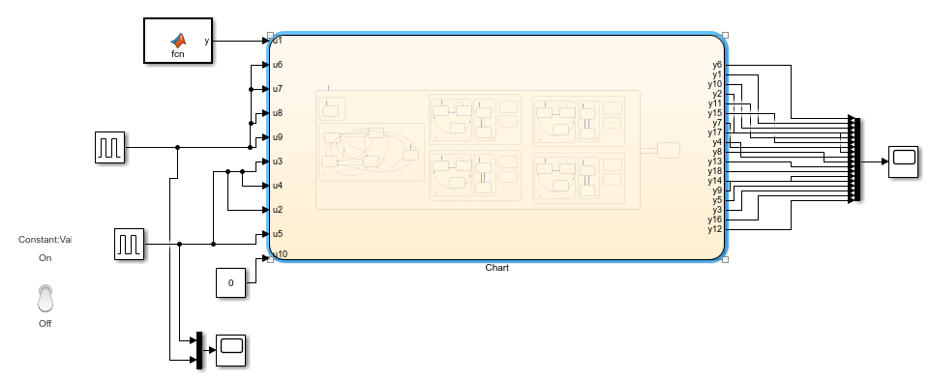
Simulink Model

Slide 7

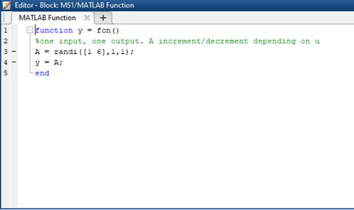
MATLAB function

Slide 8
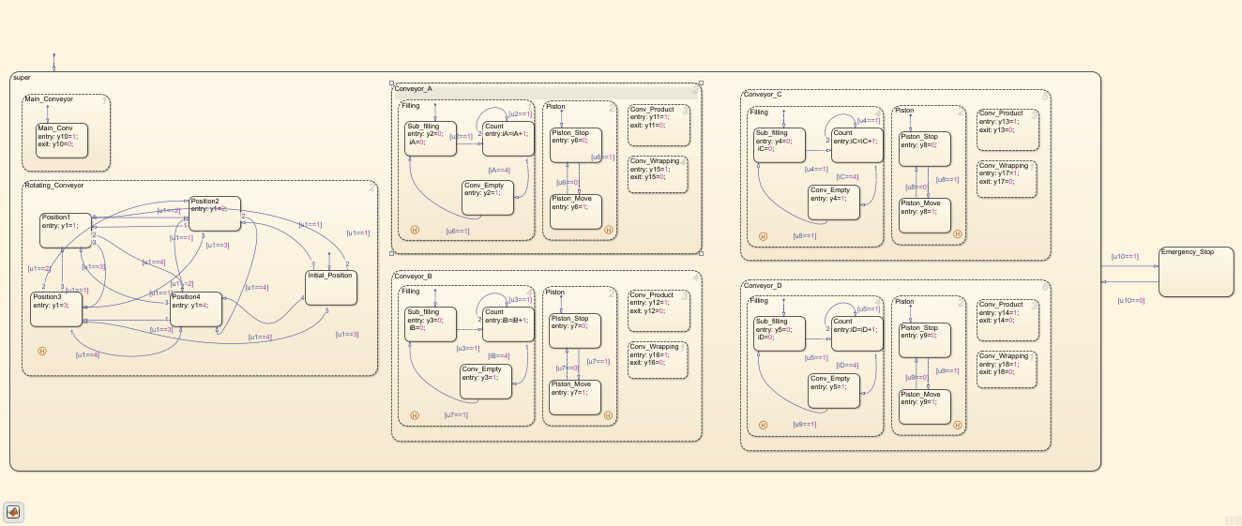
Simulink Model

Slide 9

Thank you

